Slide 1
Ensemble Learning

Slide 2
Ensemble Methods
Construct a set of base classifiers learned from the training data
Predict class label of test records by combining the predictions made by multiple classifiers (e.g., by taking majority vote)

Slide 3
General Approach of Ensemble Learning
Using majority vote or weighted majority vote
(weighted according to their accuracy or relevance)

Slide 4
Why does it work?
Suppose there are 25 base classifiers
Each classifier has error rate, ε = 0.35
Majority vote of classifiers used for classification
If all the classifiers are identical
Error rate of ensemble = 0.35
Assume classifiers are independent
Error rate of ensemble = probability of having more than half of the classifiers beong wrong:

Slide 5
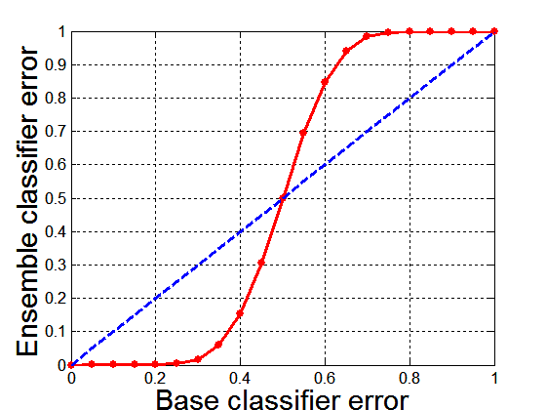
Necessary Conditions for Ensemble Methods
Ensemble Methods work better than a single base classifier if:
All base classifiers are independent of each other
All base classifiers perform better than random guessing (error rate < 0.5 for binary classification)
Classification error for an ensemble of 25 base classifiers, assuming their errors are uncorrelated.

Slide 6
Ensemble
Diverse set of algorithms
Same algorithm on the diverse set of features
Same algorithm on different set of instances
Boosting
Stacking

Slide 7
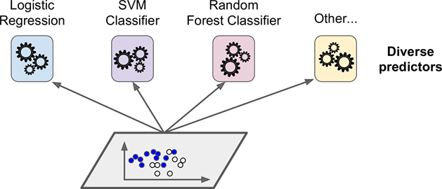
Voting Classifiers
K-Nearest Neighbor Classifier

Slide 8
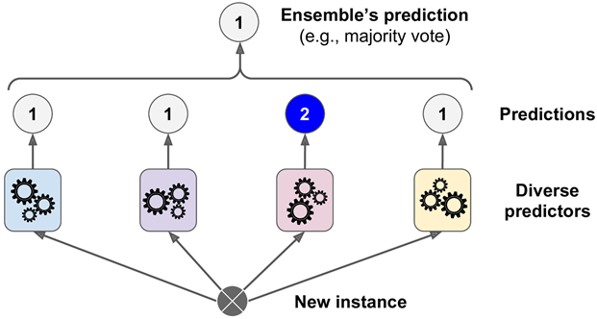
Hard Voting Classifier

Slide 9
Hard Voting Classifier
The ensemble of weak classifiers is often a strong classifier.
Weak classifier: only slightly better than random guessing
Strong classifier: high accuracy

Slide 10
Soft Voting
Predict the class with the highest class probability, averaged over all the individual classifiers.

Slide 11
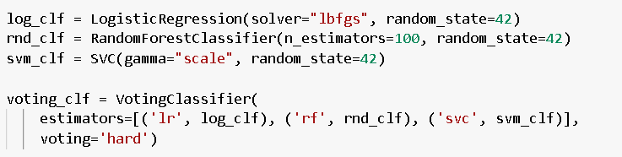
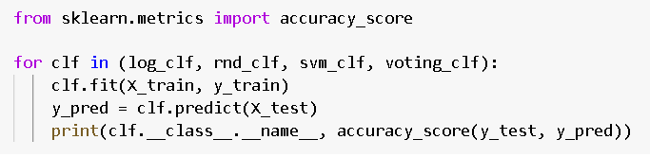
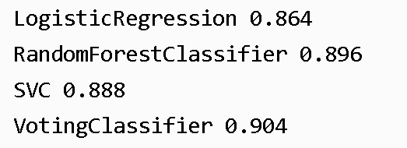
Sklearn implementation

Slide 12
Ensemble
Diverse set of algorithms
Same algorithm on the diverse set of features
Same algorithm on different set of instances
Boosting
Stacking

Slide 13
Bagging (Bootstrap AGGregatING)
Bootstrap sampling: sampling with replacement
Build classifier on each bootstrap sample
Probability of a training instance being selected in a bootstrap sample is:
1 – (1 - 1/n)^{n} (n: number of training instances)
~0.632 when n is large

Slide 14
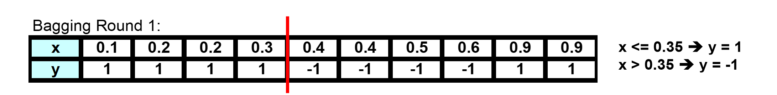
Bagging Example

Slide 15
Bagging Example

Slide 16
Bagging Example

Slide 17
Bagging Example
Summary of Trained Decision Stumps:

Slide 18
Bagging Example
Use majority vote (sign of sum of predictions) to determine class of ensemble classifier
Bagging can also increase the complexity (representation capacity) of simple classifiers such as decision stumps
Predicted Class

Slide 19
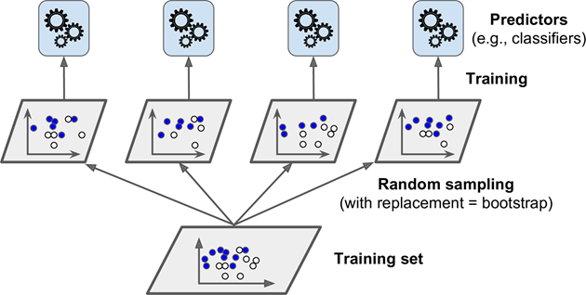
Bagging and Pasting

Slide 20
Out-Of-Bag Evaluation
On average only 63% of the training instances are sampled in average.
The remaining samples are called out-of-bag (oob) objects.

Slide 21
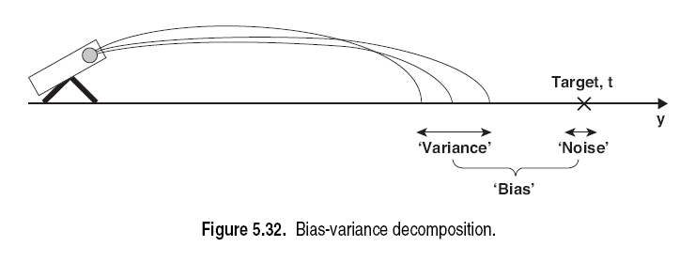
In general,
Bias is contributed to by the training error; a complex model has low bias.
Variance is caused by future error; a complex model has High variance.
- Bagging reduces the variance in the base classifiers.

Slide 22
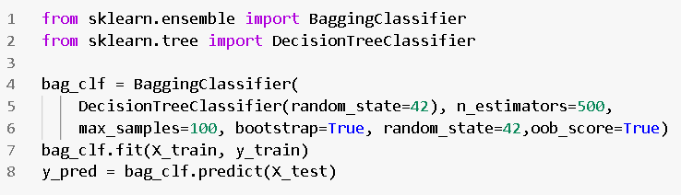

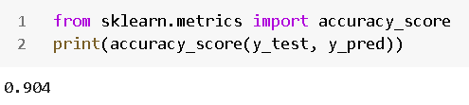
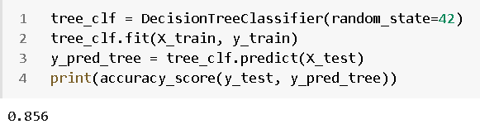

Slide 23
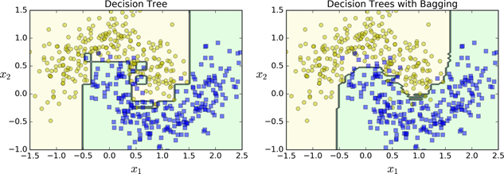
Decision Tree with Bagging and Pasting

Slide 24
Ensemble
Diverse set of algorithms
Same algorithm on the diverse set of features
Same algorithm on different set of instances
Boosting
Stacking

Slide 25
Random Patches and Random Subspaces
Random subspaces: Keeping all instances but sampling features
Random patches: Sampling both training instances and features
The BaggingClassifier class supports sampling the features as well
Sampling (features) is controlled by two hyperparameters:
max_features and
bootstrap_features.
Sampling (instances ) is controlled by two hyperparameters:
max_samples and (2) bootstrap,
Random subspaces :
by setting bootstrap=False and max_samples=1.0)
but sampling features (by setting bootstrap_features to True and/or max_features to a value smaller than 1.0)

Slide 26
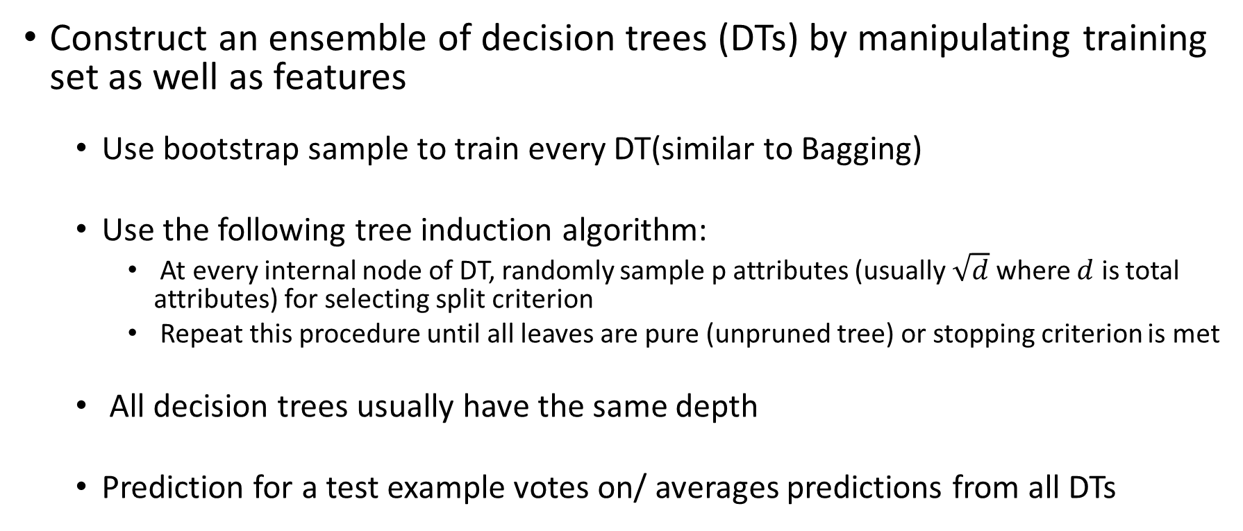
Random Forests (example of random patches)
Construct an ensemble of decision trees (DTs) by manipulating training set as well as features
Use bootstrap sample to train every DT(similar to Bagging)
Use the following tree induction algorithm:
At every internal node of DT, randomly sample p attributes (usually $\sqrt{d}$ where $d$ is total attributes) for selecting split criterion
Repeat this procedure until all leaves are pure (unpruned tree) or stopping criterion is met
All decision trees usually have the same depth
Prediction for a test example votes on/ averages predictions from all DTs

Slide 27
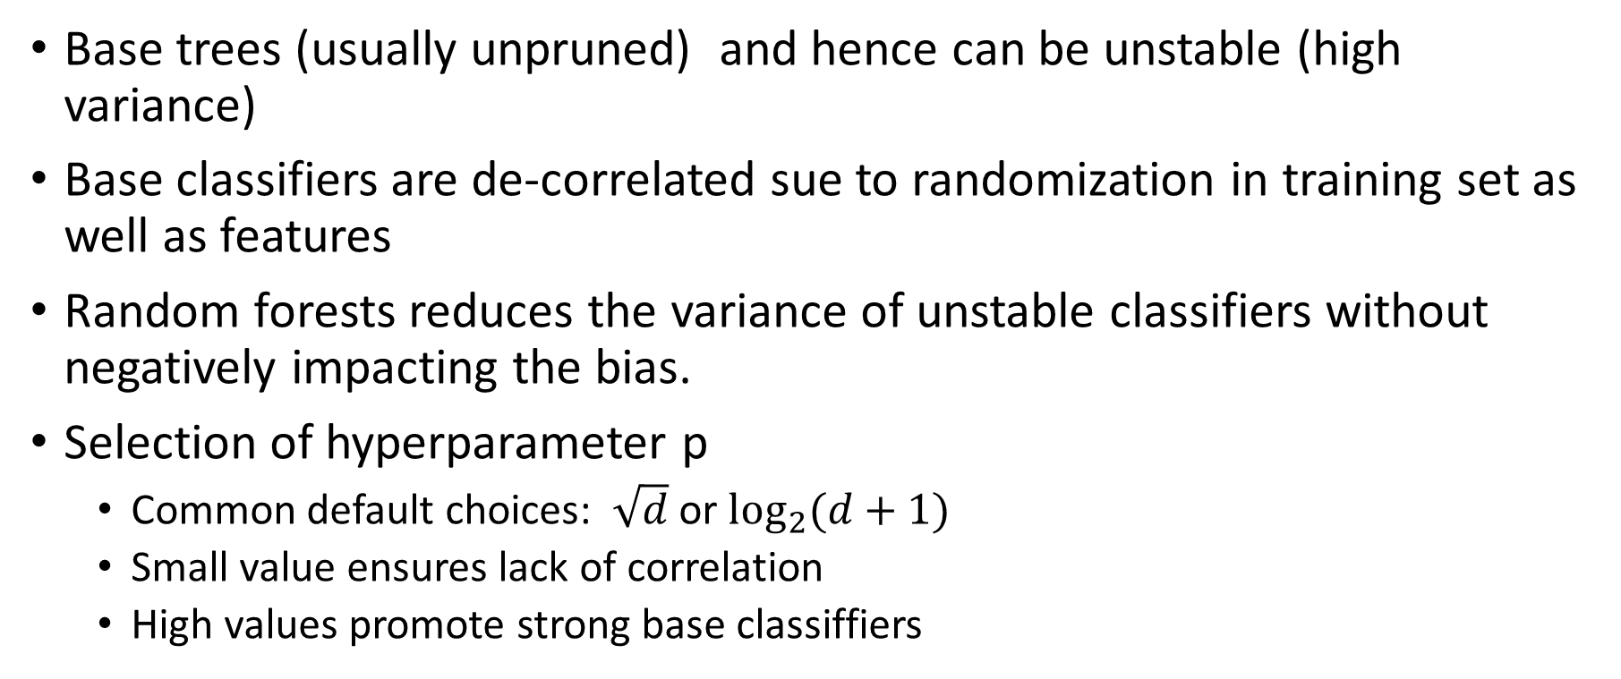
Random Forests characteristics
Base trees (usually unpruned) and hence can be unstable (high variance)
Base classifiers are de-correlated sue to randomization in training set as well as features
Random forests reduces the variance of unstable classifiers without negatively impacting the bias.
Selection of hyperparameter p
Common default choices: $\sqrt{d}$ or $\log_{2}{(d+1)}$
Small value ensures lack of correlation
High values promote strong base classiffiers

Slide 28
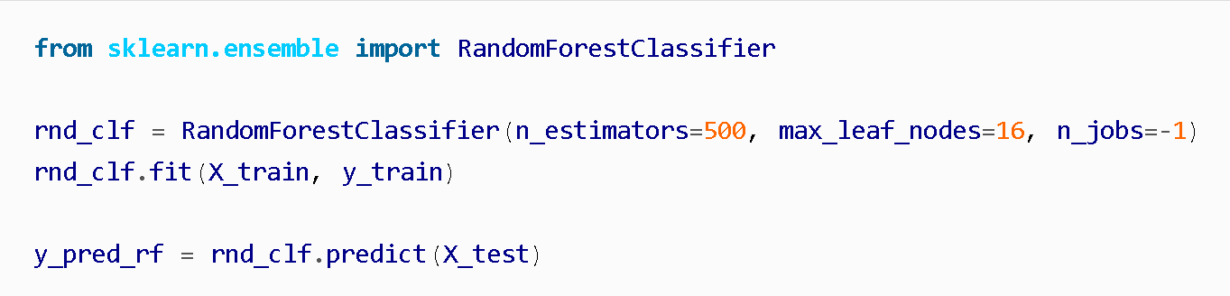
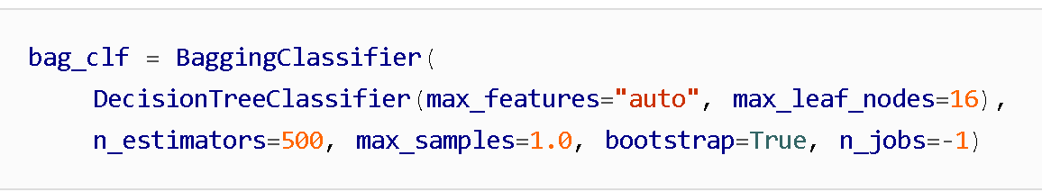

Slide 29
Tuning Random Forests characteristics
Main parameter: max_features
around sqrt(n_features) for classification
Around n_features for regression
n_estimators > 100
Prepruning might help, definitely helps with model size!
max_depth, max_leaf_nodes, min_samples_split again

Slide 30
Feature Importance
Measure the relative importance of each feature.
how much the tree nodes that use that feature reduce impurity on average
important features are likely to appear closer to the root of the tree, while unimportant features will often appear closer to the leaves (or not at all).
It is therefore possible to get an estimate of a feature’s impor‐tance by computing the average depth at which it appears across all trees in the forest.
Scikit-Learn computes this automatically for every feature after training. You can access the result using the feature_importances_ variable.

Slide 31
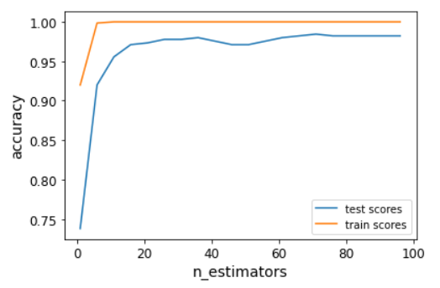
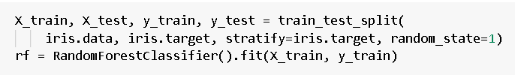
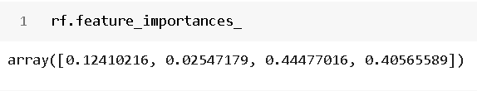
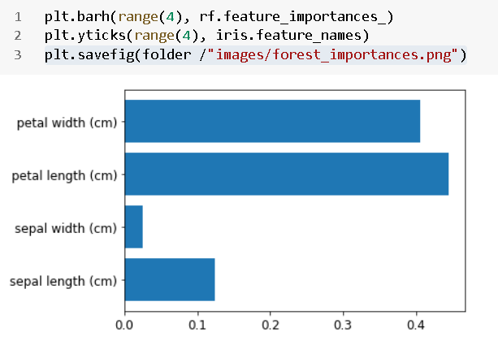
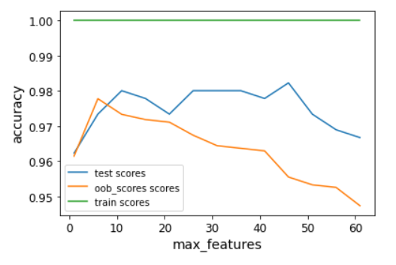

Slide 32
Extra-Trees
Use random thresholds for each feature rather than searching for the best possible thresholds (like regular Decision Trees do).
Much faster to train than regular Random Forests since finding the best possible threshold for each feature at every node is one of the most time-consuming tasks of growing a tree.
You can create an Extra-Trees classifier using Scikit-Learn’s ExtraTreesClassifier class.

Slide 33
Bagging- Summary
Works well if the base classifiers are unstable (complement each other)
Increased accuracy because it reduces the variance of the individual classifier
Does not focus on any particular instance of the training data
Therefore, less susceptible to model over-fitting when applied to noisy data
What if we want to focus on a particular instances of training data?

Slide 34
Ensemble
Diverse set of algorithms
Same algorithm on the diverse set of features
Same algorithm on different set of instances
Boosting
Stacking

Slide 35
Boosting
An iterative procedure to adaptively change distribution of training data by focusing more on previously misclassified records
Initially, all N records are assigned equal weights (for being selected for training)
Unlike bagging, weights may change at the end of each boosting round

Slide 36
Boosting
Records that are wrongly classified will have their weights increased in the next round
Records that are classified correctly will have their weights decreased in the next round
Example 4 is hard to classify
Its weight is increased, therefore it is more likely to be chosen again in subsequent rounds

Slide 37
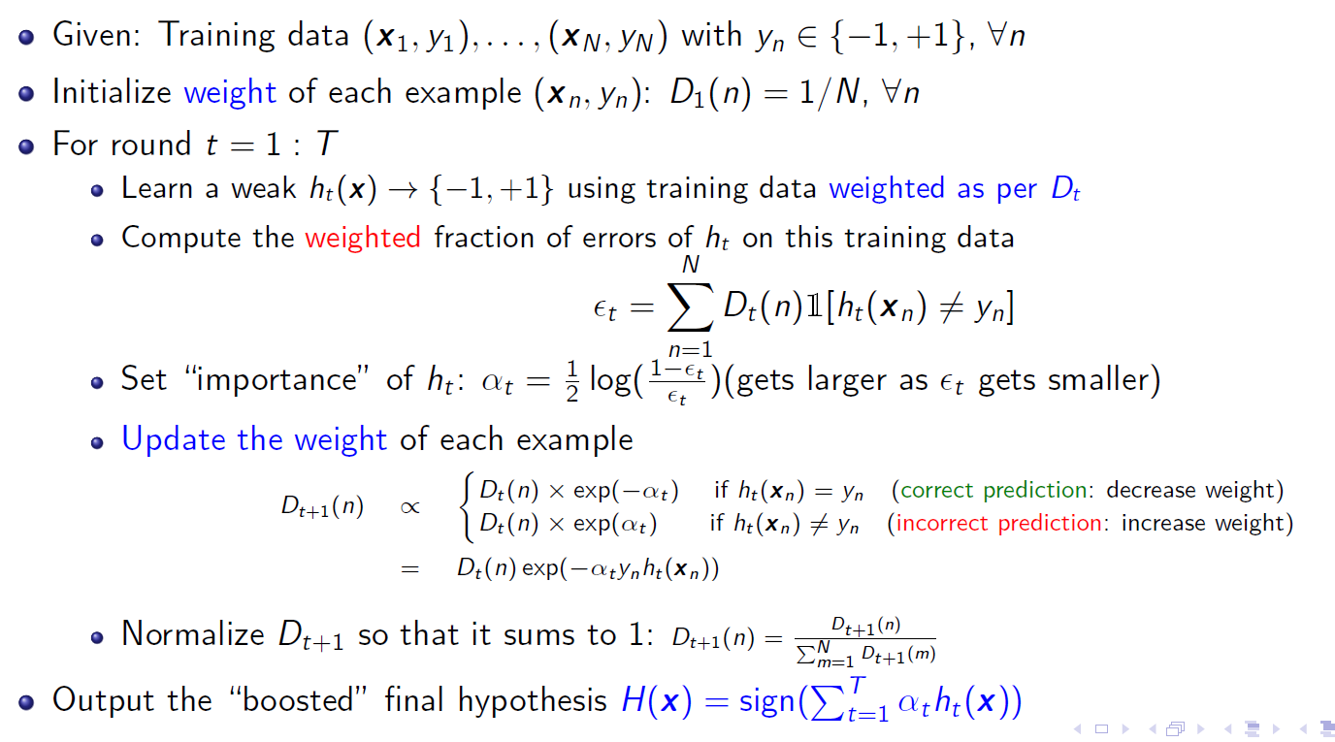
AdaBoost Algorithm
Sum of weights of misclassified examples

Slide 38
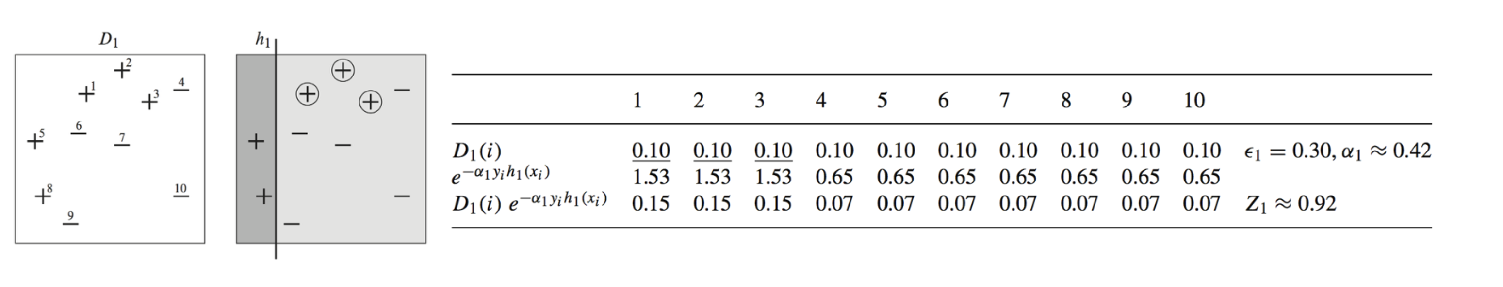
AdaBoost Example

Slide 39
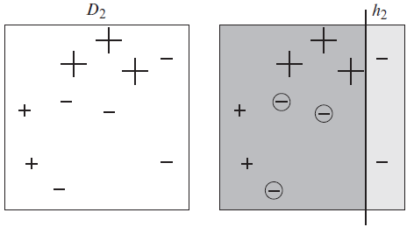

AdaBoost Example

Slide 40
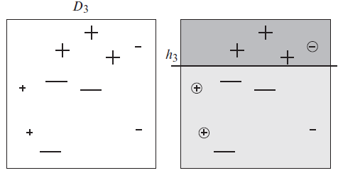

AdaBoost Example

Slide 41
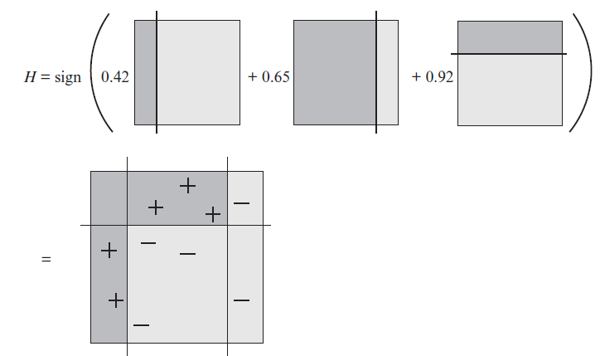

AdaBoost Example
$$sign\left(−0.42−0.65+0.92\right)=sign \left(=0.15\right)=−1$$
The combined classifier $H$ is a weighted vote of $h_{1}, h_{2} and h_{3}$

Slide 42
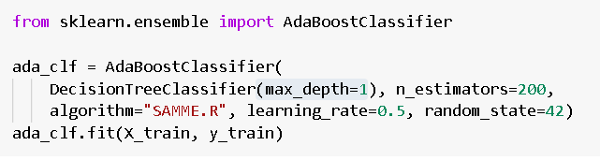
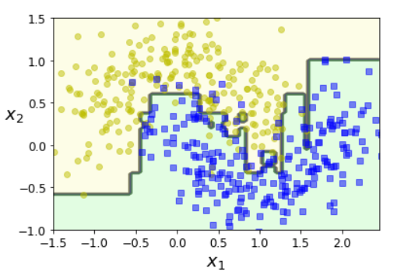
Sklearn implementation

Slide 43
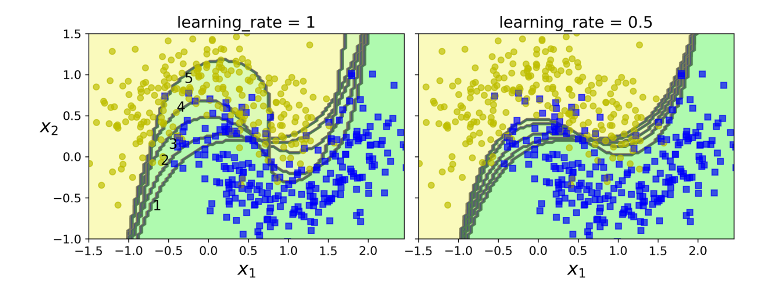
Effect of learning rate

Slide 44
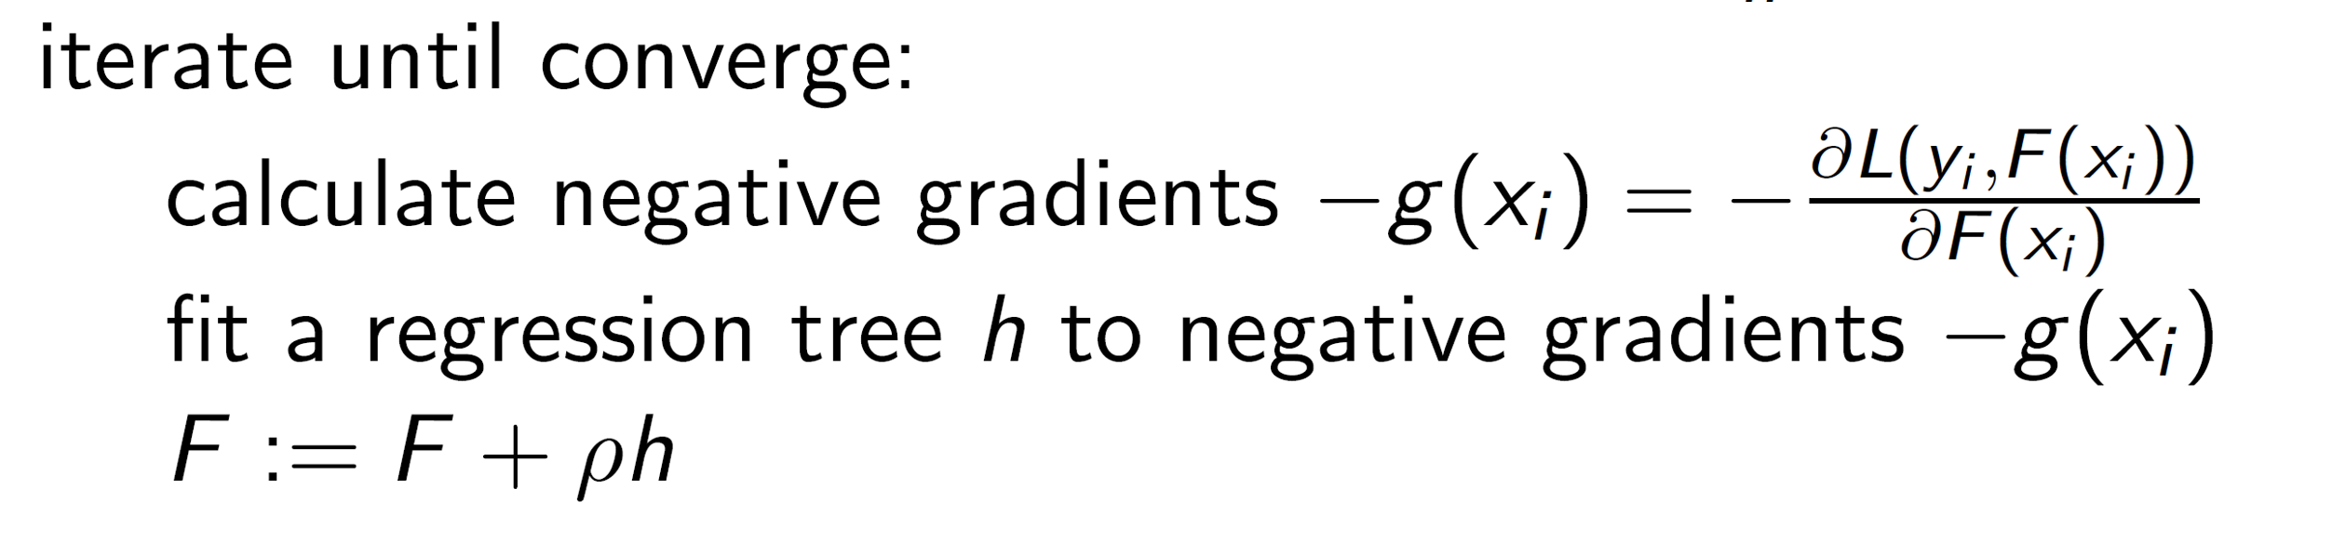
Gradient Boosting
Step 1:
Step 2:
http://www.chengli.io/tutorials/gradient_boosting.pdf

Slide 45
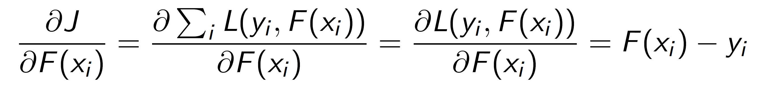
Gradient Boosting Example – Squared Loss
For Square loss, we can interpret negative of gradients as residuals
http://www.chengli.io/tutorials/gradient_boosting.pdf

Slide 46

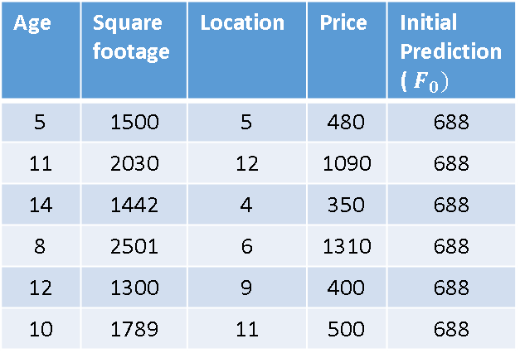
Gradient Boosting Example - Square Loss
Age | Square footage | Location | Price
5 | 1500 | 5 | 480
11 | 2030 | 12 | 1090
14 | 1442 | 4 | 350
8 | 2501 | 6 | 1310
12 | 1300 | 9 | 400
10 | 1789 | 11 | 500
Step 1- Start with a single leaf
Prediction is average of the target
${F= F}_{0}\left(x\right)=\left(\frac{480+1090+350+1310+400+500}{6}\right)$= 688
Age | Square footage | Location | Price | Initial Prediction ($F_{0})$
5 | 1500 | 5 | 480 | 688
11 | 2030 | 12 | 1090 | 688
14 | 1442 | 4 | 350 | 688
8 | 2501 | 6 | 1310 | 688
12 | 1300 | 9 | 400 | 688
10 | 1789 | 11 | 500 | 688
Inspired from : https://towardsdatascience.com/machine-learning-part-18-boosting-algorithms-gradient-boosting-in-python-ef5ae6965be4

Slide 47
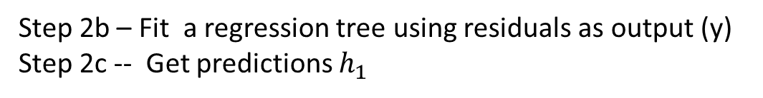
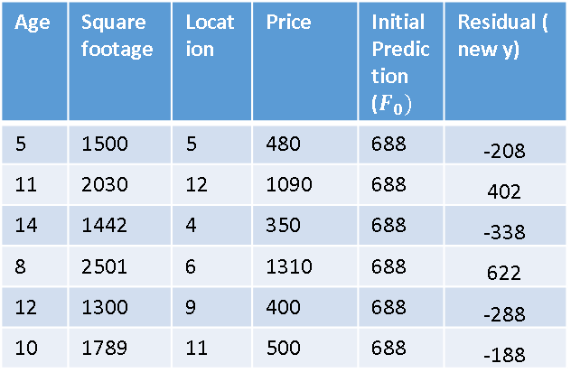
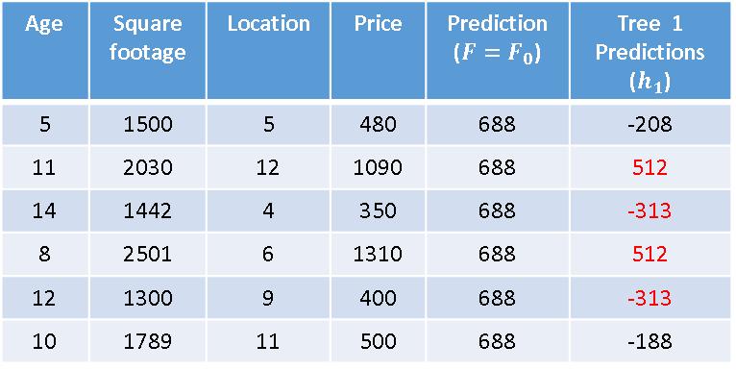
Gradient Boosting Example - Square Loss
Age | Square footage | Location | Price | Initial Prediction ($F_{0})$ | Residual ( new y)
5 | 1500 | 5 | 480 | 688 | -208
11 | 2030 | 12 | 1090 | 688 | 402
14 | 1442 | 4 | 350 | 688 | -338
8 | 2501 | 6 | 1310 | 688 | 622
12 | 1300 | 9 | 400 | 688 | -288
10 | 1789 | 11 | 500 | 688 | -188
Step 2a – Calculate negative of gradient = residual
Step 2b – Fit a regression tree using residuals as output (y)
Step 2c -- Get predictions $h_{1}$
Age | Square footage | Location | Price | Prediction (${F=F}_{0}$) | Tree 1 Predictions ($h_{1}$)
5 | 1500 | 5 | 480 | 688 | -208
11 | 2030 | 12 | 1090 | 688 | 512
14 | 1442 | 4 | 350 | 688 | -313
8 | 2501 | 6 | 1310 | 688 | 512
12 | 1300 | 9 | 400 | 688 | -313
10 | 1789 | 11 | 500 | 688 | -188
Take average to get predictions

Slide 48
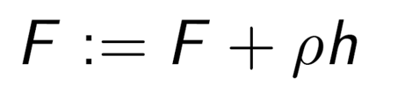

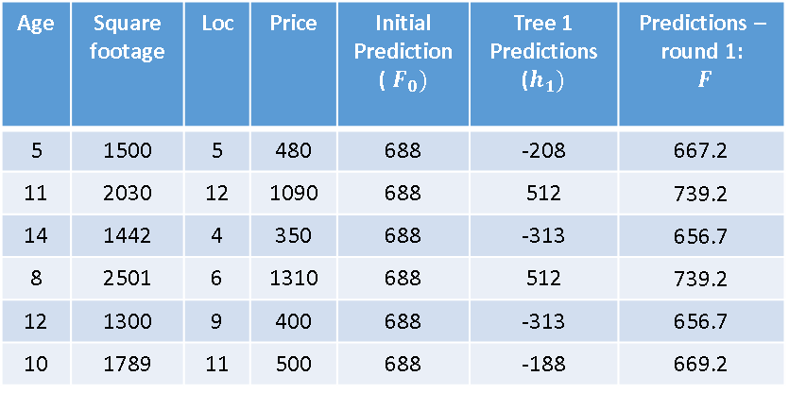
Gradient Boosting Example - Square Loss
Age | Square footage | Loc | Price | Initial Prediction ($F_{0})$ | Tree 1 Predictions ($h_{1})$ | Predictions – round 1: $F$
5 | 1500 | 5 | 480 | 688 | -208 | 667.2
11 | 2030 | 12 | 1090 | 688 | 512 | 739.2
14 | 1442 | 4 | 350 | 688 | -313 | 656.7
8 | 2501 | 6 | 1310 | 688 | 512 | 739.2
12 | 1300 | 9 | 400 | 688 | -313 | 656.7
10 | 1789 | 11 | 500 | 688 | -188 | 669.2
Step 3:
Update Prediction
$$F=F_{0}+ρ h_{1}$$
$$=688+0.1 ∗\left(−313\right)=654.2$$
Learning rate

Slide 49

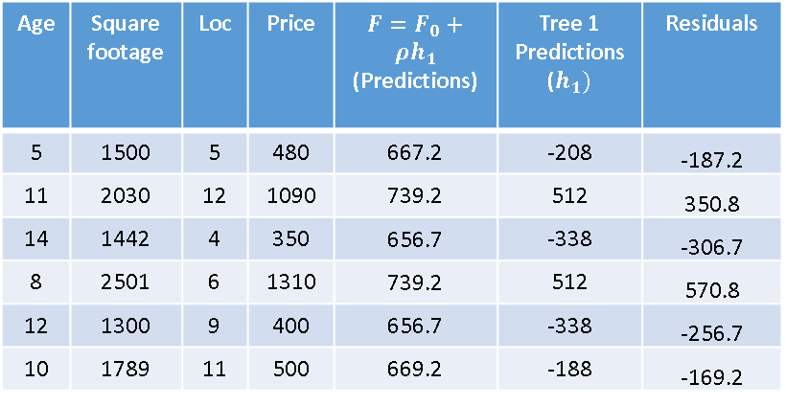
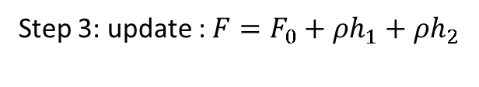
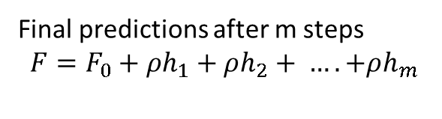
Gradient Boosting Example - Square Loss
Age | Square footage | Loc | Price | $F=F_{0}+ρh_{1}$ (Predictions) | Tree 1 Predictions ($h_{1})$ | Residuals
5 | 1500 | 5 | 480 | 667.2 | -208 | -187.2
11 | 2030 | 12 | 1090 | 739.2 | 512 | 350.8
14 | 1442 | 4 | 350 | 656.7 | -338 | -306.7
8 | 2501 | 6 | 1310 | 739.2 | 512 | 570.8
12 | 1300 | 9 | 400 | 656.7 | -338 | -256.7
10 | 1789 | 11 | 500 | 669.2 | -188 | -169.2
Repeat steps 2a, 2b, 2c and 3
Repeat step 2a : Calculate residuals
Step 2b : Build tree using the new residuals as outcome
Step 2c: get predictions $h_{2}$ from second tree
Step 3: update : $F=F_{0}+ρh_{1}+ρh_{2}$
Final predictions after m steps

Slide 50
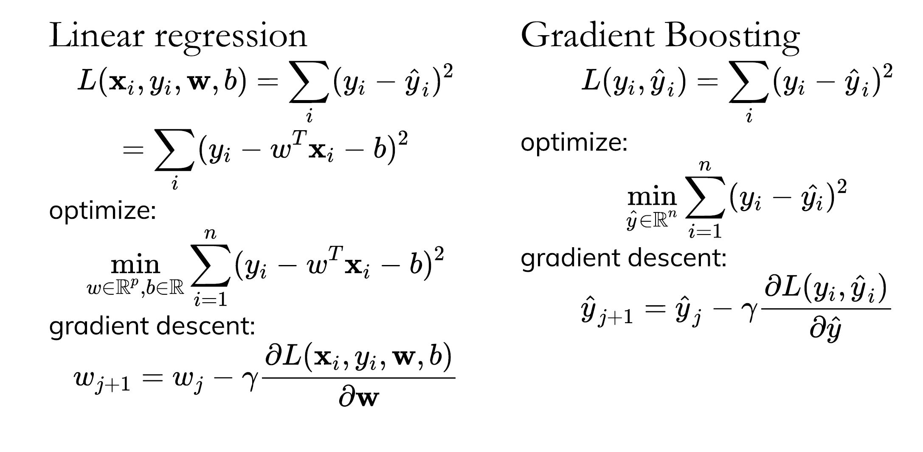
Gradient Boosting is Gradient descent

Slide 51
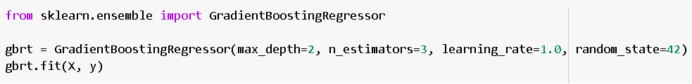
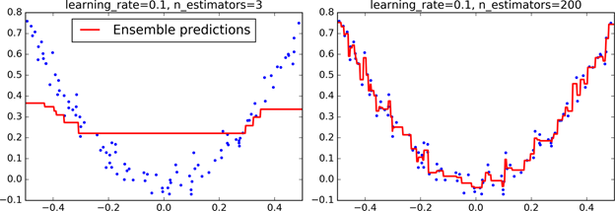
Gradient Boosting Sklearn

Slide 52
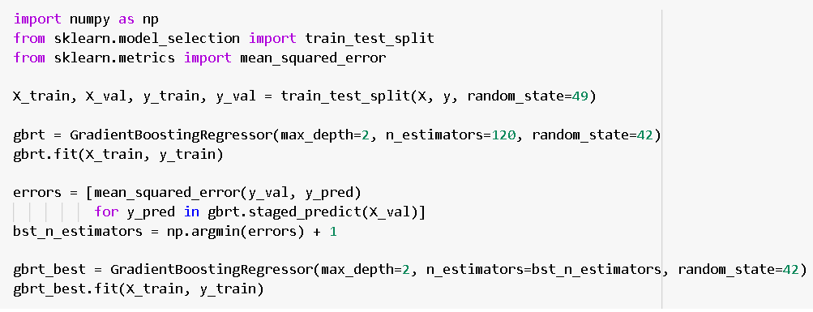
Gradient Boosting – Early Stopping

Slide 53
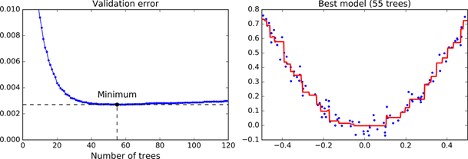
Gradient Boosting – Early Stopping

Slide 54
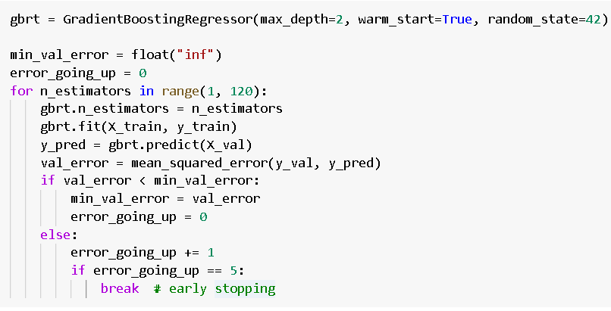
Gradient Boosting – Early Stopping – more efficient implementation

Slide 55
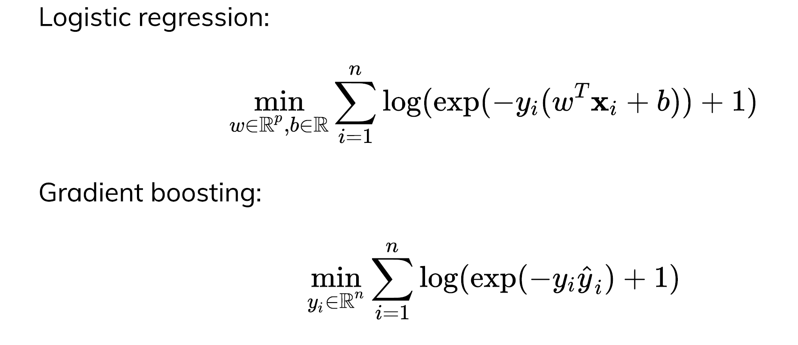
Gradient Boosting Classification
For details see : https://blog.paperspace.com/gradient-boosting-for-classification/

Slide 56
Tuning Gradient Boosting
Typically strong pruning via max_depth
Tune max_features
Tune column subsampling, row subsampling
Regularization
Pick learning rate and do early stopping
Or Pick n_estimators, tune learning rate (if not early stopping)

Slide 57
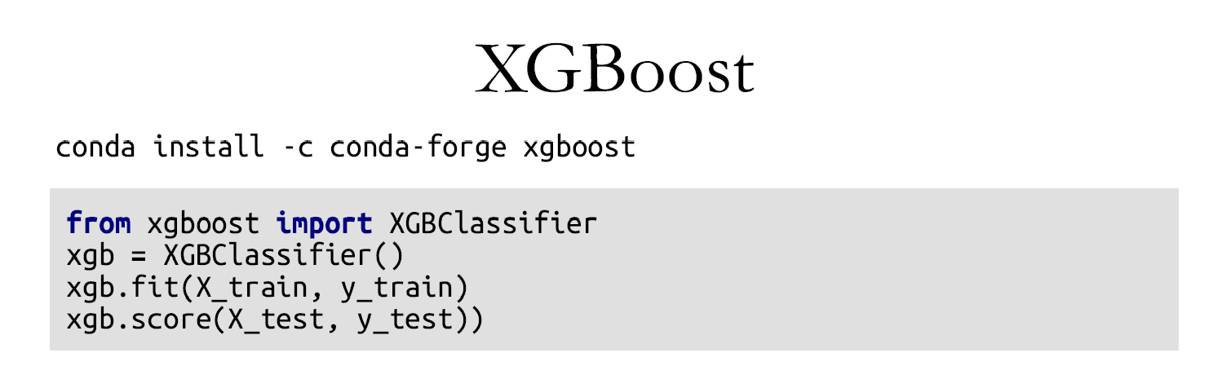
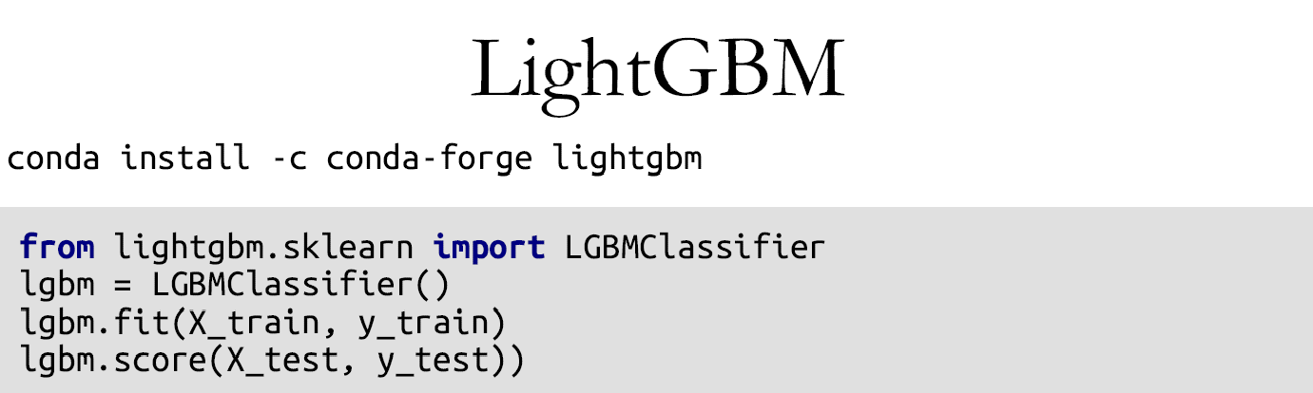

Improvements over sklearn

Slide 58
Bagging Vs Boosting
No clear winner; usually depends on the data
Bagging is computationally more efficient than boosting (note that bagging can train the M models in parallel, boosting can’t)
Both reduce variance (and overfitting) by combining different models
The resulting model has higher stability as compared to the individual ones
Bagging usually can’t reduce the bias, boosting can (note that in boosting, the training error steadily decreases)
Bagging usually performs better than boosting if we don’t have a high bias and only want to reduce variance (i.e., if we are overfitting)

Slide 59
Ensemble
Diverse set of algorithms
Same algorithm on the diverse set of features
Same algorithm on different set of instances
Boosting
Stacking

Slide 60

Stacking

Slide 61

Stacking

Slide 62

Stacking

Slide 63

Stacking

Slide 64
Code
File 1 : Ensemble_ppt_notebook

